Slide 1
Every Student Succeeds Act: Equitable Services for Eligible Non-public/Private Schools
Consolidated Planning & Monitoring

Slide 2
Keith Woodruff Equitable Services & Charter Schools Coordinator Consolidated Planning & Monitoring Keith.Woodruff@tn.gov (615) 741-3385

Slide 3
Objectives

Slide 4
Objectives
Brief overview of the Tennessee ESSA state plan
Overview of equitable services requirements under ESSA
State services if school district does not meet requirements
Ombudsman requirement
Consultation requirements
Changes to equitable share calculation
CFA Changes
Resources

Slide 5
ESSA State Plan Overview

Slide 6
Every Student Succeeds Act
ESSA provides:
more state-level decision-making authority, and
new flexibilities for programs and spending.
Tennessee is uniquely positioned to take full advantage of the opportunities.

Slide 7
ESSA State Plan Aligned with Strategic Plan
Tennessee has made education a top priority.
Fastest improving state
Clear vision and long-term goals
Comprehensive strategic plan: Tennessee Succeeds
Tennessee’s ESSA state plan is aligned with Tennessee Succeeds and the five priority areas.

Slide 8
Our Vision
Districts and schools in Tennessee will exemplify excellence and equity such that all students are equipped with the knowledge and skills to successfully embark upon their chosen path in life.

Slide 9
Ambitious Goals

Slide 10
Five Priority Areas

Slide 11
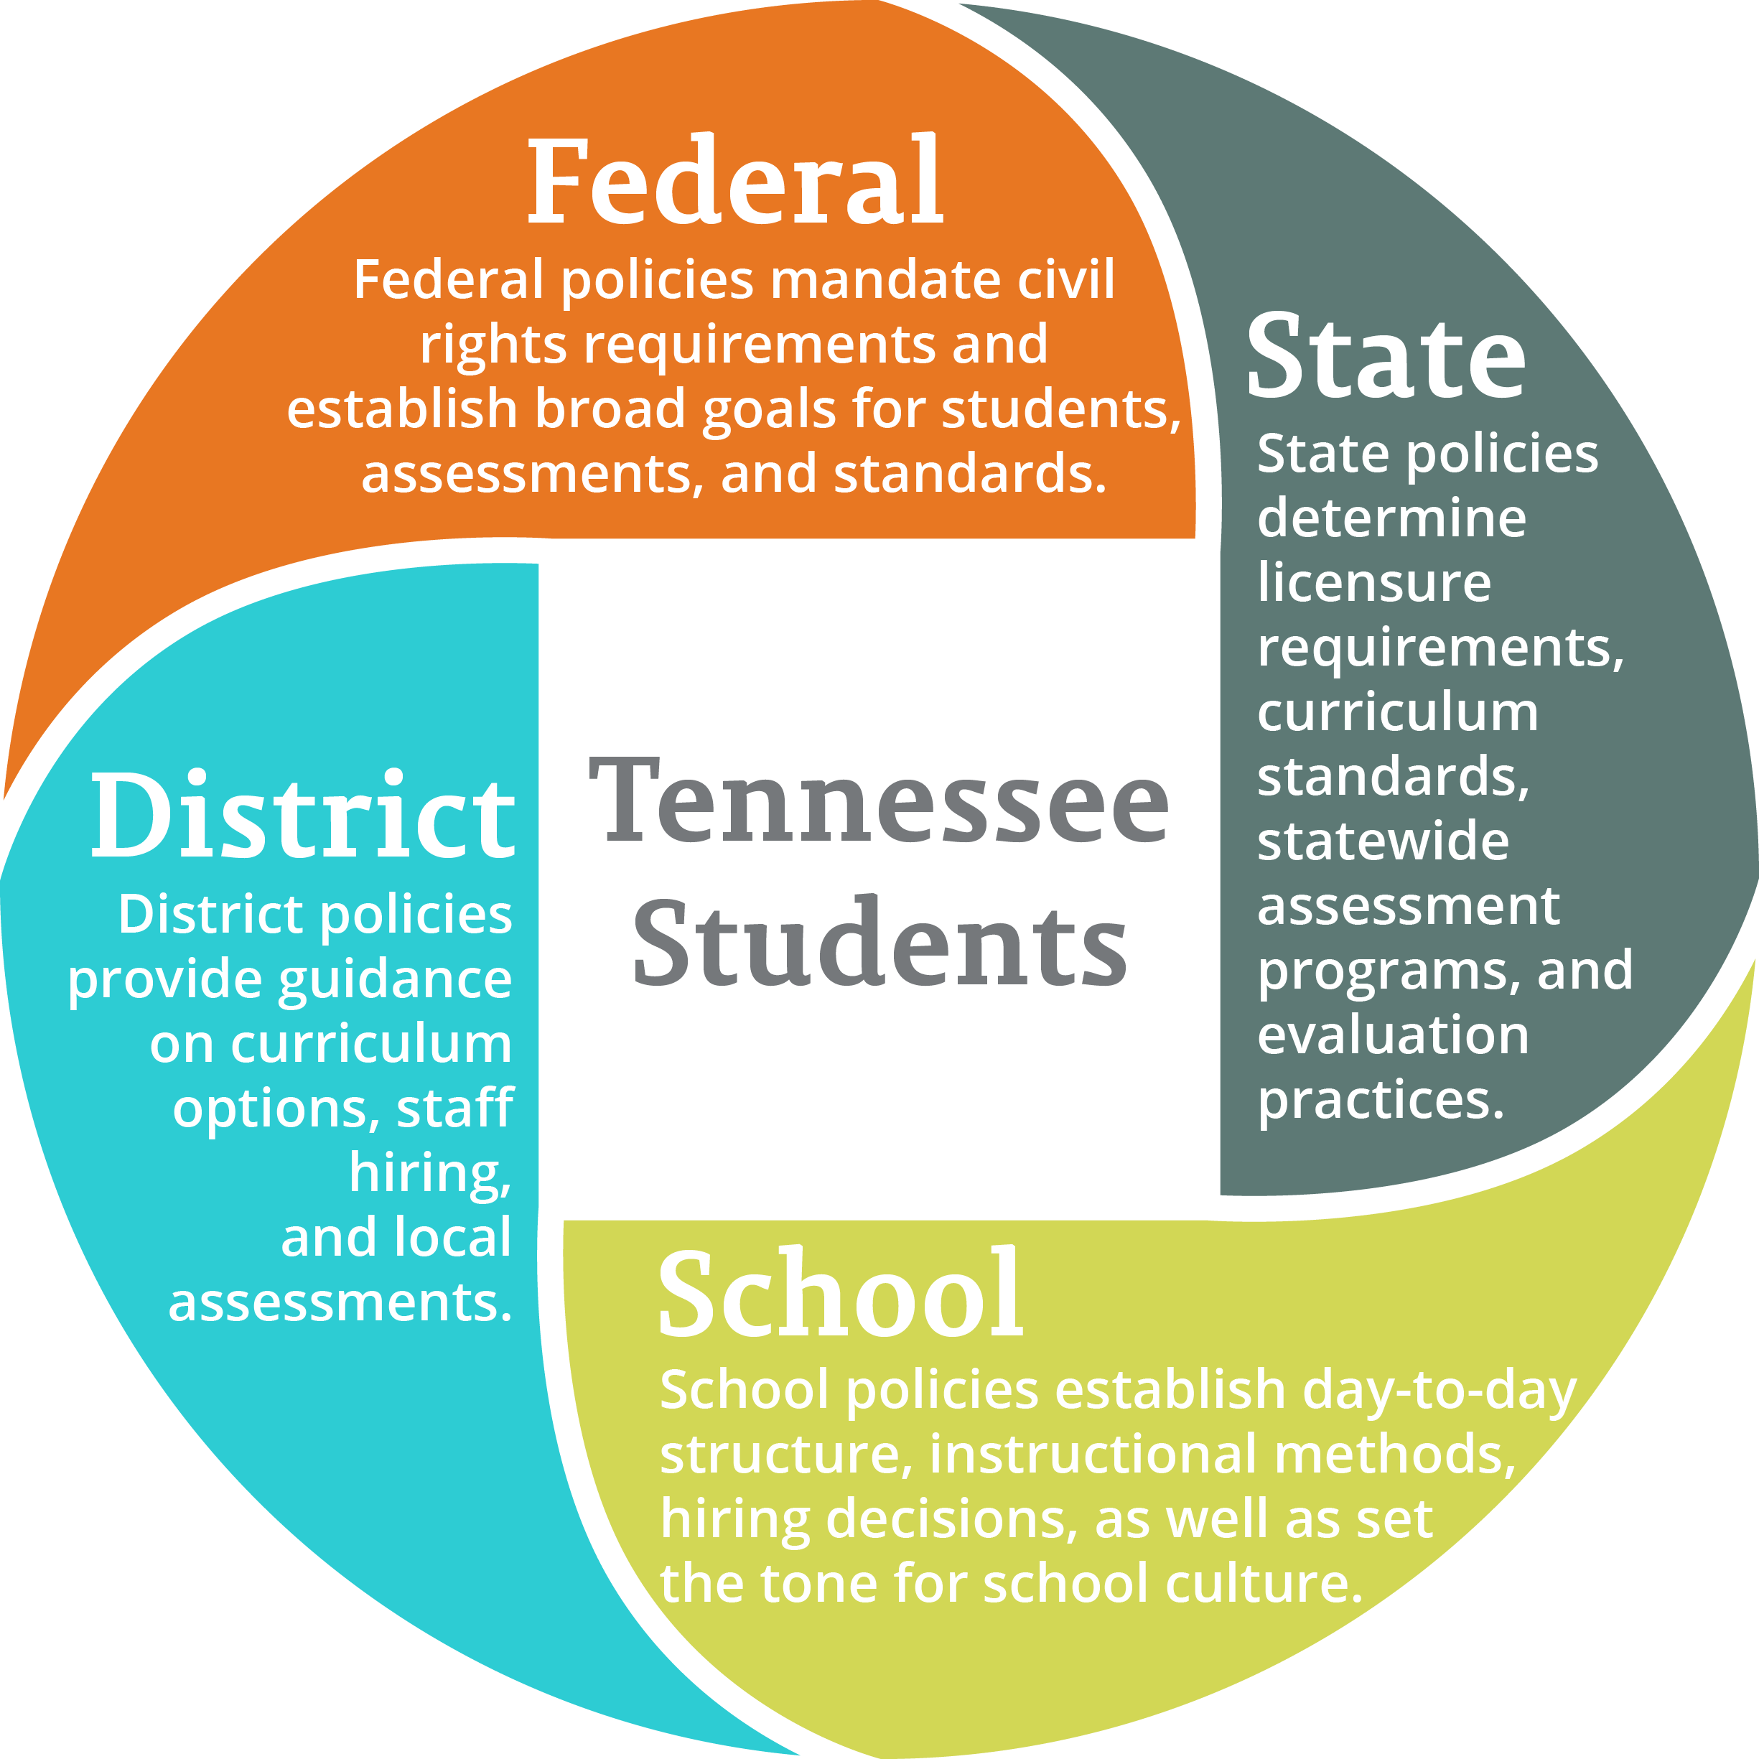
Federal-State-District-School Policy

Slide 12
Overview of Equitable Services Under ESSA

Slide 13
Overview of ESSA Changes
ESSA includes separate provisions governing equitable services for eligible private school students, teachers and other educational personnel, and families.
Notes:
Title I and programs covered under Title VIII, Part F, Subpart 1, Uniform Provisions Subpart 1—
Private Schools: Equitable Services for Private School Students, Teachers, and Other Educational Personnel

Slide 14
Overview of ESSA Changes
Many requirements are maintained from the No Child Left Behind Act (NCLB).
ESSA includes many similar changes to the equitable services requirements under both Title I and Title VIII; others changes are different.
Reference U.S. Department of Education (ED) non-regulatory guidance here.

Slide 15
Equitable Services
Equitable services requirements for non-public/private schools apply to programs under § 1117 or § 8501:
Title I, Part A (Improving Basic Programs)
Title I, Part C (Migrant Education)
Title II, Part A (Supporting Effective Instruction)
Title III, Part A (English Language Acquisition)
Title IV, Part A (Student Support & Academic Enrichment)
Title IV, Part B (21st CCLC)

Slide 16
Equitable Services
Educational services and other benefits provided under this section for private school children, teachers, and other educational personnel shall be equitable in comparison to services and other benefits for public school children, teachers, and other educational personnel participating in the program and shall be provided in a timely manner.

Slide 17
Allocating Funds for Equitable Services
Expenditures for equitable services to eligible private school children, teachers and other educational personnel, and families “must be equal to the proportion of funds allocated to participating public school attendance areas” based on the number of children from low-income families who reside in those attendance areas and attend private schools.
ESSA § 1117(a)(4)(A)

Slide 18
Allocating Funds for Equitable Services
A school district must determine the proportionate share of Title I funds available for equitable services based on the total amount of Title I funds received by the school district prior to any allowable expenditures or transfers of funds.
ESSA § 1117(a)(4)(A)

Slide 19
Notice of Allocation by the Department
The Tennessee Department of Education (the department) must provide notice in a timely manner of the allocation of funds for educational services and other benefits under each program that a school district has determined are available for eligible private school children, teachers and other educational personnel, and families.
ESSA §§ 1117(a)(4)(C) and 8501(a)(4)(C)

Slide 20
Obligation of Funds
Funds allocated to a school district for educational services and other benefits to eligible private school children, teachers and other educational personnel, and families must be obligated in the fiscal year for which the funds are received by the school district.
ESSA §§ 1117(a)(4)(B) and 8501(a)(4)(B)
Extenuating circumstances: funds not obligated are available for equitable services in the subsequent school year.

Slide 21
Obligation of Funds
The department continues to be responsible for determining school district allocations and for ensuring the school districts’ provision of equitable services to private school students.

Slide 22
State Services: When the School District Does Not Meet Obligations

Slide 23
Compliance – State Services
The department must provide equitable services directly or through contracts with public or private agencies, organizations, or institutions, if appropriate private school officials have:

Slide 24
Compliance – State Services
requested that the department provide such services directly; and
demonstrated that the school district has not met applicable equitable services requirements in accordance with the procedures for making such a request, as prescribed by the department.
ESSA §§ 1117(b)(6)(C) and 8501(c)(6)(C)

Slide 25
Right to File a Complaint
Non-public schools may file a complaint if they believe that:
timely and meaningful consultation did not occur;
the district did not give due consideration to the views of the non-public school officials; or
the funds generated or services to be provided are not equitable.

Slide 26
Right to File a Complaint
A sample complaint form is available on ePlan under TDOE Resources and on the department’s website.
Private schools must send the complaint to the school district and the department.
The school district must upload to ePlan all of their documents concerning the equitable services complaint.
The timeframe for the department’s response is 45 days.

Slide 27
School District Fiscal Repercussions
However, the department believes that districts should be responsible for all of its students.
In instances where the state must intervene to ensure that eligible students in participating non-public schools are receiving appropriate services, the state will incorporate fiscal repercussions for districts through its policies and procedures.

Slide 28
School District Fiscal Repercussions
Penalty may include the state withholding a percentage of the district’s Title I administrative dollars for these services.

Slide 29
Ombudsman Requirement

Slide 30
Ombudsman Requirement
To help ensure equitable services and other benefits for eligible private school children, teachers and other educational personnel, and families, the department must designate an ombudsman to monitor and enforce ESEA equitable services requirements under both Title I and Title VIII.
ESSA §§ 1117(a)(3)(B) and 8501(a)(3)(B)

Slide 31
Tennessee Ombudsman Position
Tennessee has added the ombudsman position to the CPM staff for planning for the 2017-18 school year to provide support and assistance to districts in the transition to ESSA.

Slide 32
Tennessee Ombudsman Position
Tennessee’s designated ombudsman will serve as the primary point of contact for addressing questions and concerns from non-public/private school officials and school districts regarding the provision of equitable services under Titles I and VIII.

Slide 33
Tennessee Ombudsman Position
The CPM equitable services and charter schools coordinator has been designated as the ombudsman responsible for ensuring that equitable services requirements are met by school districts.
Keith.Woodruff@tn.gov
(615) 741-3385 – desk
(615) 917-3465 – mobile

Slide 34
Consultation Requirements

Slide 35
Consultation Requirement
Goal of consultation: agreement between the school district and appropriate private school officials on how to provide equitable and effective programs for eligible private school children.
The results of the agreement following consultation must be uploaded to ePlan by the school district by August 1.
Notes:
The results of the agreement following consultation must be uploaded to ePlan by the school district to satisfy the requirement of transmittal to the SEA’s equitable services ombudsman under § 1117(b)(1).

Slide 36
Consultation Topics Expanded
Topics subject to consultation for Title I have been expanded to include the following:
how the proportion of funds allocated for equitable services is determined;
whether the school district will provide services directly or through a separate school district or third-party contractor;
when, including the approximate time of day, services will be provided;
Notes:
Under § 1117(b)(1) topics subject to consultation have been expanded to include the following:
How the proportion of funds allocated for equitable services is determined.
Whether the school district will provide services directly or through a separate school district or third-party contractor.
When, including the approximate time of day, services will be provided.

Slide 37
Consultation Topics Expanded
whether to provide equitable services to eligible private school children by pooling funds or on a school-by-school basis; and
whether to coordinate and use funds available for Title I equitable services with funds available for equitable services under programs covered under § 8501(b).
Reference § 1117(b)(1) for other consultation issues that shall be included in the process.

Slide 38
Consultation Topics Expanded
Topics subject to consultation for Title VIII have been expanded to include the following:
how the amount of funds available for equitable services is determined;
whether the school district responsible for providing equitable services will provide those services directly, through a separate school district, or through a third-party contractor; and

Slide 39
Consultation Topics Expanded
whether to provide equitable services to eligible private school participants:
by creating a pool or pools of funds with all of the funds allocated under programs covered under § 8501(b), or
on a school-by-school basis based on the proportionate share of funds available to provide services in each school.
Reference § 8501(c) for other consultation issues that must be included in the process.

Slide 40
Disagreement Over Use of Contractors
If the school district disagrees with the views of the private school officials on the provision of services through a contract, the school district must provide to the private school officials a written explanation of the reasons why the school district has chosen not to use a contractor.

Slide 41
Consultation Before the School District Makes Decisions
The consultation shall occur before the school district makes any decision that affects the opportunities of eligible private school children, teachers, and other educational personnel to participate in programs and shall continue throughout the implementation and assessment of activities under this section.

Slide 42
Discussion of Service Delivery Mechanisms
The consultation shall include a discussion of service delivery mechanisms that the school district could use to provide equitable services to eligible private school children, teachers, administrators, and other staff.

Slide 43
Written Affirmation
Each school district shall maintain in its records, and provide to the department in their consolidated funding application (CFA), a written affirmation signed by officials of each participating private school that the meaningful consultation required by this section has occurred.

Slide 44
Written Affirmation
The written affirmation shall provide the option for private school officials to indicate such officials’ belief that timely and meaningful consultation has not occurred or that the program design is not equitable with respect to eligible private school children.
A sample affirmation is available in the related documents section of the CFA.

Slide 45
Written Affirmation
If private school officials do not provide such affirmation within a reasonable period of time, the school district shall forward to the department the documentation that such consultation has, or attempts at such consultation have taken place.

Slide 46
Changes to Equitable Share Calculation

Slide 47
Changes in Equitable Share Calculation
ESSA includes significant changes in the calculation of equitable share.
Title I § 1117(a)(4)(A)(ii) requires that the proportionate share of funds for equitable services be determined based on:
the total amount of Title I funds received by a district prior to any allowable expenditure or transfers by the district.

Slide 48
Changes in Equitable Share Calculation
For all programs, §§ 1117(a)(4)(B) and 8501(a)(4)(B) require that funds allocated to districts for educational services and other benefits to eligible non-public school children be obligated in the fiscal year for which the funds are received by the district.

Slide 49
Changes in Equitable Share Calculation
Additionally, §§ 1117(a)(4)(C) and 8501(a)(4)(C), require states to provide timely notice to appropriate non-public school officials in the state of the allocation of funds for equitable services that districts have determined are available for eligible non-public school children.

Slide 50
Support & Technical Assistance
CPM regional consultants will:
provide support and technical assistance during late fall and during the funding application review process, and
ensure that the proportionate share is calculated correctly.
The equitable share calculation will also be checked during monitoring visits—including on-site visits to at least one non-public school in an school district being monitored.

Slide 51
Timeline

Slide 52
Timeline
The 2017-18 Intent to Participate Form was available for the school district to download from TDOE Resources on ePlan.
This form was sent by the school district to all non-public schools physically located within the school district attendance area.
Completed and returned by January 29, 2017—even if private schools do not wish to participate.

Slide 53
Timeline
Each school district used the Intent to Participate Form to complete the Private School Participation Form.
The Private School Participation Form was submitted to the department via ePlan in Feb. 2017.
Each school district should now be facilitating consultations with participating private schools.
Private schools should sign off on the affirmation of consultation after the consultation.

Slide 54
Timeline
Each school district should upload their affirmations of consultation in the related documents section of their CFA.
The consultation agreement between the school district and the private school shall be uploaded to the LEA Document Library by August 1.

Slide 55
Consolidated Funding Application

Slide 56
Title I-A Equitable Services
New page to be completed
Share is calculated before any transfers or deductions
Based on percentage of participating, low income, non-public students
Family engagement amount calculated for non-public school students if one percent is required
Signed affirmation of consultation in Related Documents
No carryover of funds into the next fiscal year
Some exceptions are permissible, but funds must be carried over for non-public services in the next year.

Slide 57
Title I-A Equitable Services
The Title I non-public equitable share is based on the percentage of non-public low income students residing in Title I participating schools.
Example:
Total Public Low Income: 1,350
Total Non-public Low Income: 150
Total Low Income: 1,500
Percentage of Non-public Low Income: 10% (150/1,500)

Slide 58
Title I-A Equitable Services
The Title I equitable non-public share is calculated before any funds are transferred or set aside.
Example:
Total Title I Allocation: $1,000,000
Percentage of Non-public Low Income: 10%
Total Title I Equitable Share: $100,000
($1,000,000 *10%)

Slide 59
Title I-A Equitable Services
Family engagement funds for non-public schools must be funded from the equitable share calculated.
If the LEA is required to spend one percent on family engagement, so is the non-public.
Example:
Total Title I Allocation: $1,000,000
1% Family Engagement: $10,000
Percentage of Non-public Low Income: 10%
Non-public Family Engagement: $1,000
($10,000 * 10%)

Slide 60
Title I-A Equitable Services
Administrative costs for non-public programs come out of equitable share.
The amount must be determined during consultation.
Signed affirmation of consultation must be uploaded to Related Documents.
Narrative questions to describe and/or identify:
Consultation process
Student eligibility criteria
Methods for evaluating program effectiveness
Family engagement activities

Slide 61
Title I-A Equitable Services
Assurances
Engaged in timely, meaningful, and ongoing consultation
Delivery of services timely and in accordance with agreements made during consultation
Obligate funds for Title I non-public school students during the fiscal year that it was awarded:
Limited carryover of funds will be permitted.
Any carryover funds would carry-over to the next year non-public school services.

Slide 62
Title I-A Equitable Services
Removal of non-public inputs/information from:
PPA
Title I Program Details
Title I Student Eligibility

Slide 63
Title II-A, Equitable Non-public Services
New questions for equitable services:
Describe the consultation process between the LEA and the non-public/private school(s). Include important dates, modes of communication, and information provided to non-public/private school representatives. (Upload affirmation of consultation(s) in Related Documents.)
Describe the professional development activities to be provided to participating non-public school teachers, principals, and other school leaders.

Slide 64
Title II, A: Equitable Services Assurances
The LEA has engaged in timely and meaningful consultation, as required by ESEA 8501(c) and maintains all required documentation to support such consultation.
The LEA will ensure that all supported activities are approved and provided in a timely fashion, in accordance with agreements made as a result of meaningful consultation with non-public/private school representatives.

Slide 65
Title II, A: Equitable Services Assurances
The LEA will obligate all non-public/private school funds during the fiscal year in which allocated and in support of activities agreed upon as a result of required consultation.
The LEA will engage in ongoing consultation with participating non-public/private school representatives as necessary to ensure continued communication, monitor agreed-upon activities, and to determine the effectiveness of provided activities.

Slide 66
Non-Public/Private Schools Page
Summary of results of the non-public survey conducted earlier in the year
The page must be completed to indicate non-public school responses if any schools are listed.
The total number of non-public students is the total number enrolled in the non-public school.
Total used to determine equitable share of Title II, III, and IV

Slide 67
Non-Public/Private Schools Page
Total number of non-public low-income students living in participating attendance area
The total must match low income on the Title I Equitable Services page.
Title I non-public participants
Of those living in attendance areas, students meeting Title I educational eligibility requirements
NOT the number of non-public low-income students
Title III non-public participants
If non-public schools elect to participate in survey
Title III Program Details describes services to be offered

Slide 68
Resources

Slide 69
Resources
U.S. Department of Education Non-Regulatory Guidance and Resources:
ESEA Ensuring Equitable Services Title I Toolkit
ESSA Non-Regulatory Guidance: Fiscal Changes & Equitable Services
ESEA Non-Regulatory Guidance: Title I - Equitable Services for Eligible Private School Students
ESEA Non-Regulatory Guidance: Title IX (ESSA Title VIII) - Equitable Services for Eligible Private School Students/Teachers
ESSA Non-Regulatory Guidance: Title II, Part A - Building Systems of Support for Excellent Teaching and Leading
ESSA Non-Regulatory Guidance: Title III – English Learners
ESSA Non-Regulatory Guidance: Title IV, Part A – Student Support and Academic Enrichment Program

Slide 70
Questions

Slide 71
Questions

Slide 73
FRAUD, WASTE, or ABUSE
Citizens and agencies are encouraged to report fraud, waste, or abuse in State and Local government.
NOTICE: This agency is a recipient of taxpayer funding. If you observe an agency director or employee engaging in any activity which you consider to be illegal, improper or wasteful, please call the state Comptroller’s toll-free Hotline:
1-800-232-5454
Notifications can also be submitted electronically at:
http://www.comptroller.tn.gov/hotline

